Slide 3
The two stars represent Cabarete and Jacmel which identify the initial and primary ministry sites of the mission.

Slide 4
Bethesda Mission Facts
1957 – Pastor Jovin responded to the leading of the Lord to begin community prayer meetings every night in different homes.
1965 – Pastor Jovin began full time biblical studies & led a small church in Cabaret.
1970 – Pastor Jovin and Emma were married and travelled to England to further their education (Seminary / nursing)

Slide 5
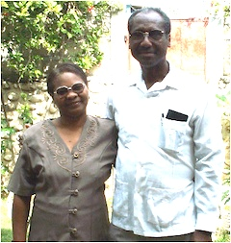
Outline
Bethesda Mission Facts
1974 – Our family return to Haiti and founded the Oeuvre Evangelique Baptist de Bethesda
1986 – the mission was formally licensed by the Haitian government
1980’s OEBB Partnership
with Emmanuel
International

Slide 6
Bethesda Community Impact
Ministry – 9 church plants
Education – 7 elementary & 2 high schools
Healthcare – 3 clinics
Orphanage/boarding homes (1girl / 1 boy)
Micro-loan program for women in churches
Livestock distribution women (chicken, goat, pigs)
Reforestation program
Sanitation program
Small business loan program

Slide 7
Bethesda Mission Structure
Bethesda Missions
West /Ouest
Southeast / Sud
Delmas
Cabaret
Cazale
Marbial
Lavoute
Font Blanc
Lamandier
Conoyer
Rechimeau
Church
School
Church
School
Church
School
Church
School
Church
Church
School
Church
School
Church
Church
School
Clinic
Clinic
Clinic

Slide 8
Reconstruction Work to Date
Marbial: School (580 students - active) Church (250 member - active)
Lavoute: Church Construction: (active)
Cabarete: Church (600 membership - active) School (200-250 students - active)
Community Housing (pending)
Special thanks to Heath Evangelical Church who after the earthquake send $15,000.00 for house repair and reconstruction. We rebuilt one family home and we helped 8 others families to repair their homes.

Slide 9
Project Calendar: 3 Years
 | Jan | Feb | Mar | Apr | May | June | July | Aug | Sep | Oct | Nov | Dec
2010
2011
2012
PHASE 1: RELIEF – TEMPORARY HOUSING AND FOOD SUPPLIES
Phase 2: Education Funding
CHOLERA PROJECT PHASE 1
CHOLERA
PROJECT PHASE 1
PHASE 3: REPAIR & RECONSTRUCTION

Slide 10
OEBB Mission Structure
West /Ouest
Southeast / Sud
Delmas
Cabaret
Cazale
Marbial
Lavoute
Font Blanc
Lamandier
Conoyer
Rechimeau
Church
School
Church
School
Church
School
Church
School
Church
Church
School
Church
School
Church
Church
School
Clinic
Clinic
Clinic

Slide 11
Jacmel

Slide 12
Jacmel: Damaged School Building

Slide 13
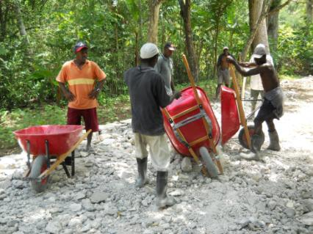
Jacmel: Demolition

Slide 14
Jacmel: Ground Breaking

Slide 15
Jacmel: Ground Breaking

Slide 16
Jacmel: School Construction

Slide 17
Jaceml: School Construction

Slide 18
Jacmel: School Construction

Slide 19
Jacmel: School Construction

Slide 20
Jacmel: School Construction

Slide 21
Jacmel: School Construction

Slide 22
Jacmel: Completed Classroom

Slide 23
Jacmel: Elementary School

Slide 24
Jacmel: Road Construction

Slide 25
Jacmel: Completed Road Construction

Slide 26
OEBB Mission Structure
West /Ouest
Southeast / Sud
Delmas
Cabaret
Cazale
Marbial
Lavoute
Font Blanc
Lamandier
Conoyer
Rechimeau
Church
School
Church
School
Church
School
Church
School
Church
Church
School
Church
School
Church
Church
School
Clinic
Clinic
Clinic

Slide 27
Cabaret

Slide 28
Cabaret Ground Breaking

Slide 29
Cabarete Church after Earthquake

Slide 30
Cabarete Church Repair

Slide 31
Cabarete Church Repair

Slide 32
Cabarete Church Repair

Slide 33
Future Work
Mission Short and Long Term
Gospel Ministry – Evangelization, training for leaders and resource centre
Health care – clinical care, medical supplies, dental care and medial teams
Education – school supplies, and support for school feeding programs
Community Development– Self-sustaining Coffee Program
Reconstruction
Cabaret Repair Church
Cabaret School Reconstruction

Slide 34
Preaching the Gospel

Slide 35
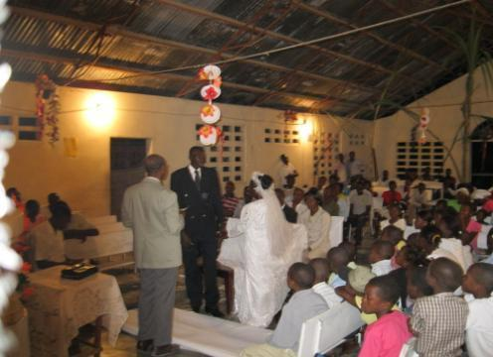
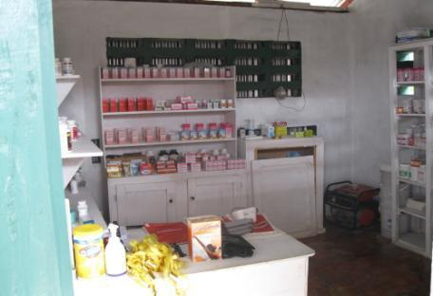
Health Care & Community Services

Slide 36
Boys Home

Slide 37
Girls Home

Slide 38
We are excited about the future.
We are blessed with the opportunity to preach the Gospel, train ministry leaders and create self-sustaining community development projects.

Slide 39
Thank You
On behalf of the Bethesda Mission – Thank you for the opportunity to share the work of the mission. We appreciate your prayers and future consideration to partner with;
Church - the preaching of the gospel
Christian Education and Training
Healthcare and Sustainable development in Haiti
We are excited about God’s plan for Haiti and your support is of great encouragement.
Please continue to pray for the work in Haiti.

